Slide 1

0
Customer Segmentation using Machine Learning
By: Nandini Mundra
Sushant Shrivastava
Tanmoy Debnath
Vinay Pandhariwal
Confidential. © Stream Intelligence Ltd. All rights reserved.

Slide 2



Agenda
1
1
Introduction: Business Case
2
Clustering
3
Hierarchical Clustering
4
K-means Clustering

Slide 3



1
Business Case

Slide 4


















Business Case – Predicting Successful Music Production
3
Cluster
music B
Cluster music D
Cluster music C
Cluster music A
Target is to appear at Billboard’s weekly to 40
Cost per single could up to 300K USD
Music Intelligence Solution using clustering to predict if a music will be accepted by market
Increase success rate from 1 out of 10 to 8 out of 10

Slide 5
2
Clustering

Slide 6


Statistical Learning Categorization
5
Statistical Learning
Unsupervised
Learning
Supervised
Learning
Clustering
Predictive Model

Slide 7
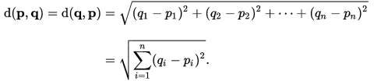
Clustering
6
Process of grouping a set of physical or abstract objects into clusters
(example: customer, product etc.)
A cluster is a collection of data objects that are similar to one another within the same cluster and are dissimilar to the objects in other clusters
Similarity is calculated based distance between point
Common distance measure is Euclidian distance

Slide 8
2
Hierarchycal Clustering

Slide 9
Hierarchical Clustering
8
Start with each data point in its own cluster

Slide 10
Hierarchical Clustering
9
Combine two nearest clusters (Euclidian, Centroid)

Slide 11
Dendogram
11
Heights represent the distance between point/cluster

Slide 12
Finding Meaningful Cluster
12
How to see which cluster have the most action movies?
use this command:
tapply(movies$Action, clusterGroups, mean)
Exercise: Can you find the characteristic of each cluster?
Hint:
Add the cluster as one of the variable in the data
Load dplyr library
Use aggregate and summarise function

Slide 13
Common scenario
13
Movie | Action | Romance | Rating | Revenue (in USD)
A | 1 | 1 | 5 | 200
B | 0 | 1 | 4 | 150
C | 0 | 0 | 3 | 50
D | 1 | 1 | 4 | 120
Tips:
- Normalize the data

Slide 14
2
K-means Clustering

Slide 15
K-Means Clustering
15
Objective : High Level Description
Group data into K-clusters by:
Determining the k centroid
Group the data points to the nearest centroid
Algorithm works by iterating between two stages until the data points converge

Slide 16

K-Means Illustrations
16
Suppose k=3

Slide 17
K-Means Illustrations
17
1. Start with random positions of centroids.
Iteration = 0

Slide 18




K-Means Illustrations
18
Start with random positions of centroids.
Assign each data point to closest centroid
Iteration = 1

Slide 19

K-Means Illustrations
19
Start with random positions of centroids.
Assign each data point to closest centroid
Move centroids to center of assigned points (recalculating C)
Iteration = 1

Slide 20

K-Means Illustrations
20
Start with random positions of centroids.
Assign each data point to closest centroid
Move centroids to center of assigned points
Iterate till minimal cost
Iteration = 3

Slide 21
What potentially can go wrong?
21
Start with random positions of centroids.
Assign each data point to closest centroid
Move centroids to center of assigned points
Iterate till minimal cost
Iteration = 3

Slide 22
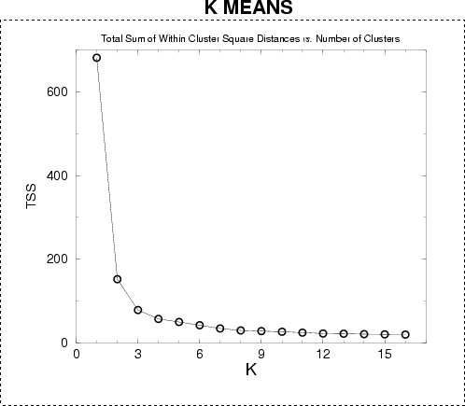
Optimum Number of Cluster Illustrations
22
Optimum Number of Cluster
TSS = Total Sum of Square Error K = Number of cluster
Euler’s Plot

Slide 23
Thank You
23

